Slide 1
Redes industriais
Redes Foundation Fieldbus
Aula 10
Prof. Diovani Milhorim

Slide 2
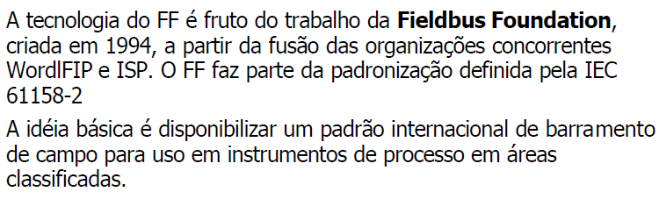
Redes Foundation Fieldbus

Slide 3
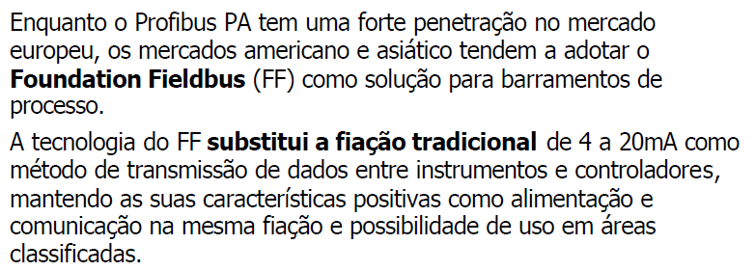
Redes Foundation Fieldbus

Slide 4
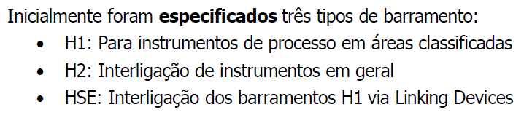
Redes Foundation Fieldbus

Slide 5
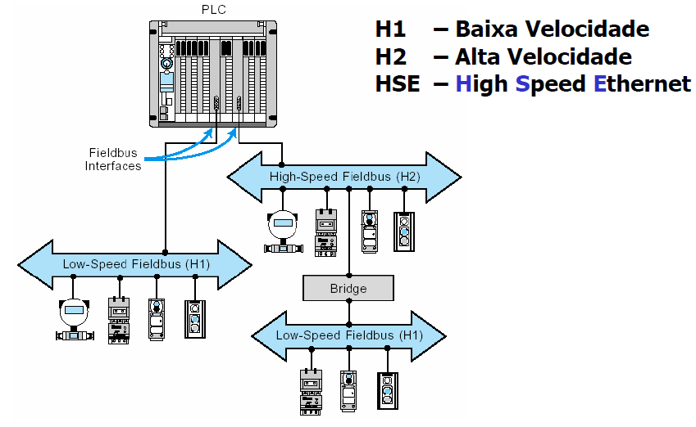
Redes Foundation Fieldbus

Slide 6
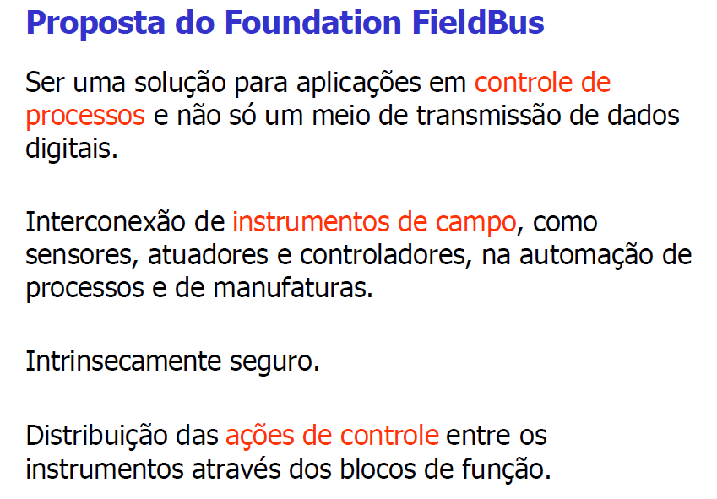
Redes Foundation Fieldbus

Slide 7
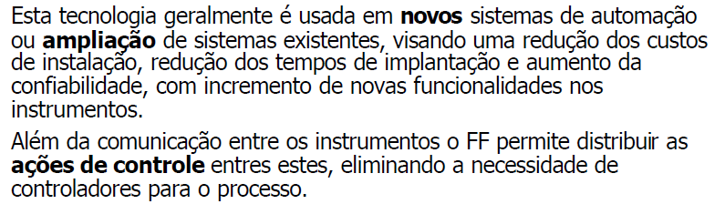
Redes Foundation Fieldbus

Slide 8
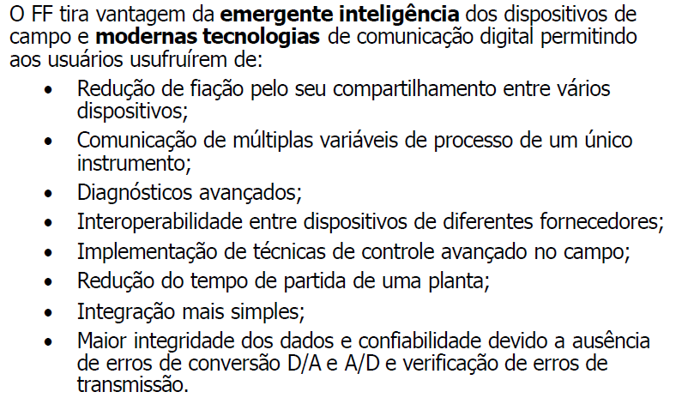
Redes Foundation Fieldbus

Slide 9
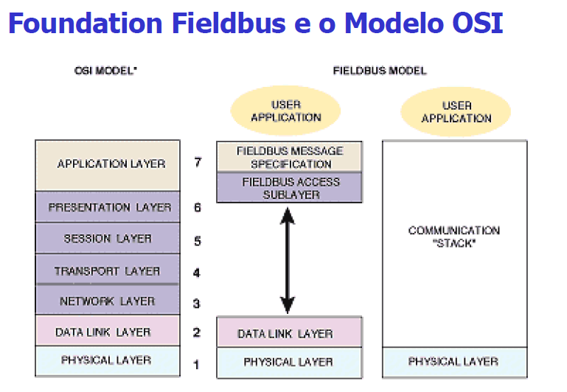
Redes Foundation Fieldbus

Slide 10
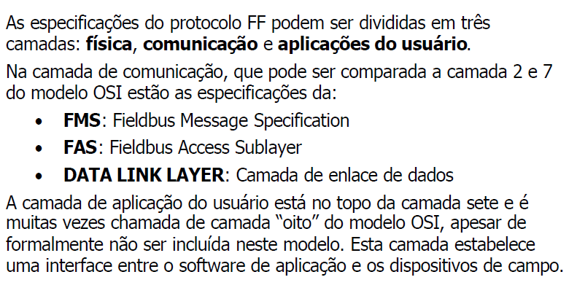
Redes Foundation Fieldbus

Slide 11
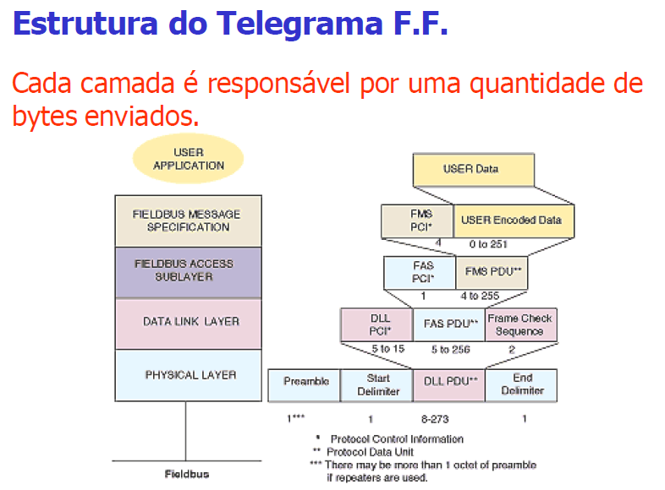
Redes Foundation Fieldbus

Slide 12
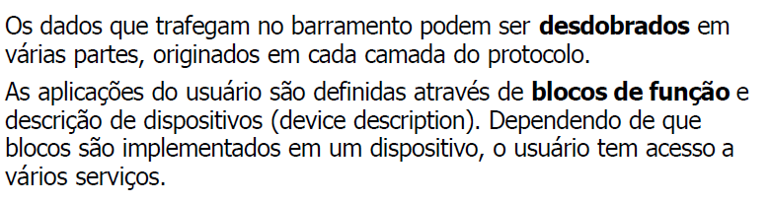
Redes Foundation Fieldbus

Slide 13
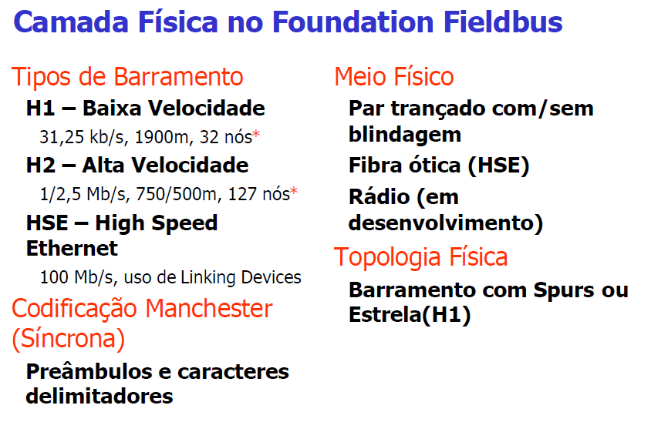
Redes Foundation Fieldbus

Slide 14
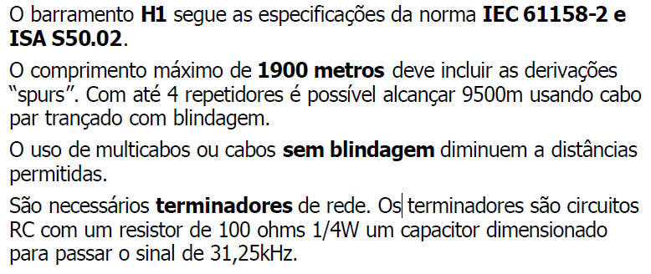
Redes Foundation Fieldbus

Slide 15
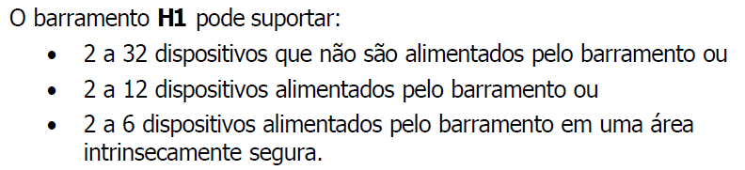
Redes Foundation Fieldbus

Slide 16
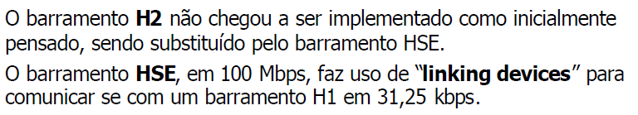
Redes Foundation Fieldbus

Slide 17
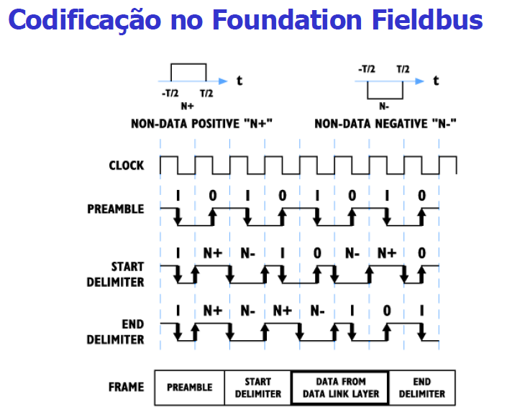
Redes Foundation Fieldbus

Slide 18
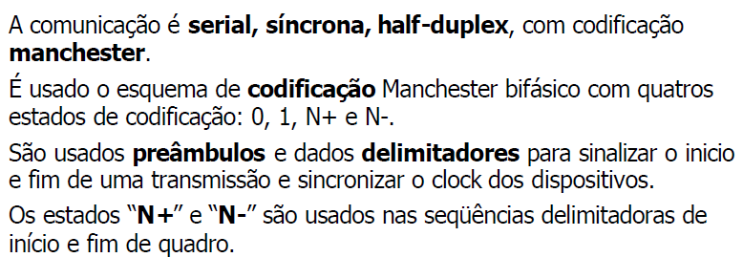
Redes Foundation Fieldbus

Slide 19
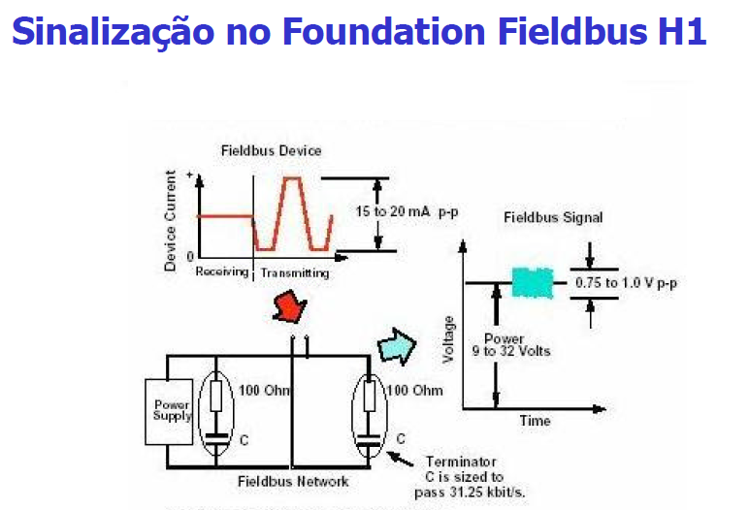
Redes Foundation Fieldbus

Slide 20
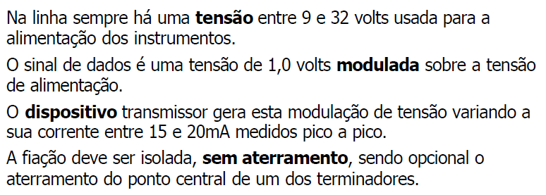
Redes Foundation Fieldbus

Slide 21
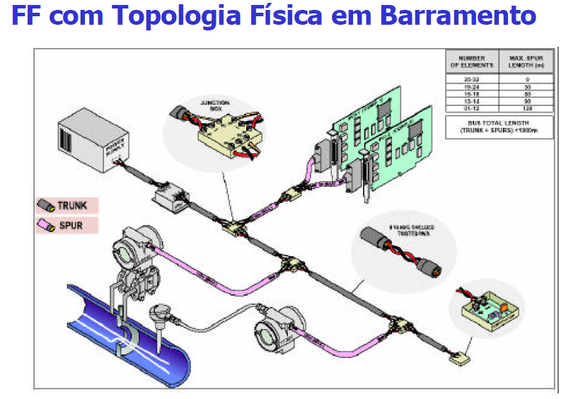
Redes Foundation Fieldbus

Slide 22
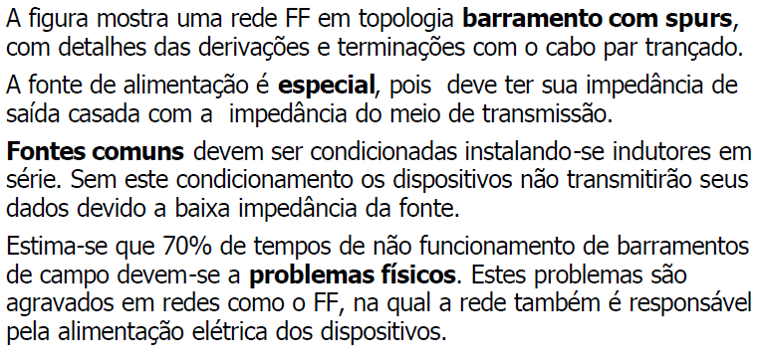
Redes Foundation Fieldbus

Slide 23
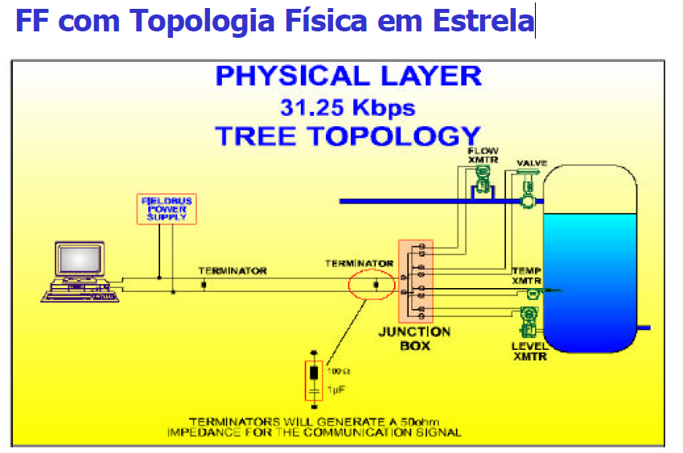
Redes Foundation Fieldbus

Slide 24
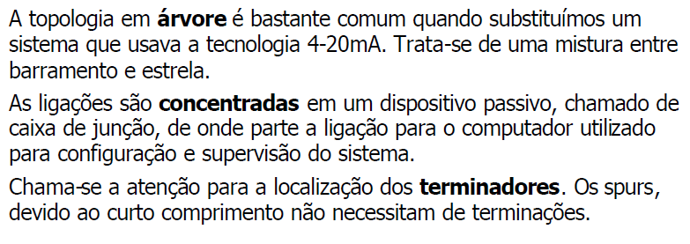
Redes Foundation Fieldbus

